Slide 1
Adam Curry - Final Project Airbnb
DSC 530 – T301 - Exploratory Data Analysis
Bellevue university

Slide 2
Presentation Outline
Hypothesis questions
Description of variables used in analysis
Histogram analysis/Descriptive statistics
Probability Mass Function (PMF)
Cumulative Distribution Function (CDF)
Modeling Distributions
Scatter Plots and Correlation
Hypothesis Testing
Regression Analysis

Slide 3
Hypothesis questions
Do hosts with less response time tend to get worst reviews than high response time hosts?
Do Real Beds cost more or get better reviews than non-real beds?
What impacts a location’s cleaning cost?
Do locations with higher cleaning fees have better cleaning reviews?
Do long time hosts tend to get better reviews?
Does the number of days the venue is open impact the price points?

Slide 4
Description of variables used in analysis
property_type – The description of the Airbnb (e.g. house, condo, tent) (string) Variable used as filter
room_type – the sleeping quarters for the guest (string) Variable used as filter
bed_type – the type of bed the guest sleeps on (string) Variable used as filter
availability_365 – the number of days the Airbnb is open to rent (int)
host_since – the length of time the host has hosted an Airbnb (date)
host_response_rate – the % of time the hosts responds to an inquiry (float)
number_of_reviews – The number of reviews received for the Airbnb as of the date the data was pulled (int)
review_scores_rating – the Airbnb average ratings (float)
review_scores_cleanliness – the Airbnb cleanliness rating (1-10 scale) (int)
review_scores_communication – communication rating (1-10 scale) (int)
price – the price per night for the guest (float)
cleaning_fee – the cleaning fee charged to the guest (float)

Slide 5
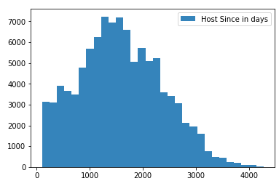
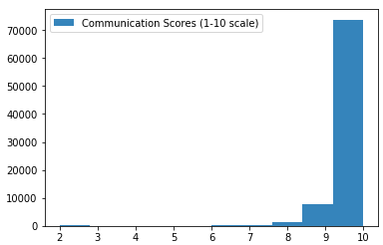
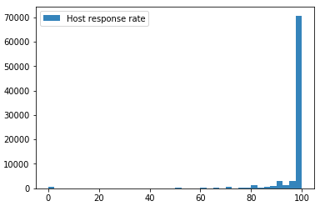
Histogram analysis 1 of 3
Host Since in days
There don’t appear to be significant outliers, but the number of days a host has hosted an Airbnb appears to be right (positive) skewed. There are less hosts that have, what appears to be, 3000 or more days of experience.
count 101016 | mean 1580.75 | std 781.28 | min 103 | 25% 1013 | 50% 1544 | 75% 2121 | max 4268 | mode 2262
kurtosis = -0.42 | skew = .26
Communication Scores (1-10 scale)
There appears to be outliers within the 2-3 range scores, but this is interval data and could help in analysis further downstream. The data is left skewed, as there are significantly more 9-10 rated reviews.
count 83817 | mean 9.83 | std 0.6 | min 2 | 25% 10 | 50% 10 | 75% 10 | max 10 | mode 10
kurtosis = 62.21 | skew = -6.52
Host response rate
There appears to be outliers where hosts don’t respond at all (>500). This could help determine communication scores. The data is left skewed, as there are significantly more 9-10 rated reviews.
count 84039 | mean 96.85 | std 11.15 | min 0 | 25% 100 | 50% 100 | 75% 100 | max 100 | mode 100
kurtosis = 41.92 | skew = -5.96

Slide 6
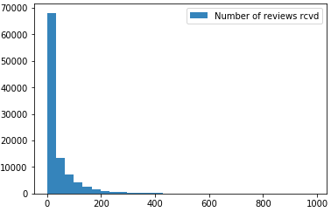
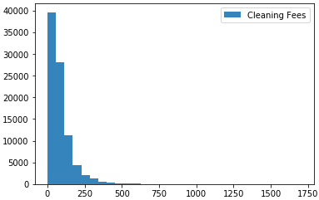
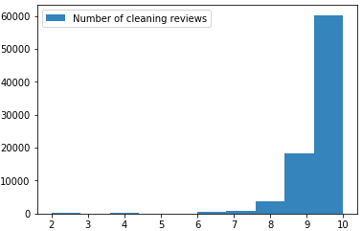
Histogram analysis (cont’d) 2 of 3
Number of reviews rcvd
There appear to be significant outliers and there are a significant number of zeros, these will be removed, as we only care about hosts with reviews. There are some hosts with nearly 1000 reviews. The number of reviews appear to be right skewed. It appears hosts are more likely to have fewer reviews.
count 101016 | mean 39.07 | std 64.72 | min 0 | 25% 2 | 50% 12 | 75% 48 | max 987 | mode 0
kurtosis = 16.31| skew = 3.3
Cleaning Fees
There appears to be outliers as one cleaning fee is $1703. This seems unreasonable and will be removed when comparing cleaning reviews. The data is right skewed, as there are significantly more hosts that don’t require a cleaning fee.
count 88108 | mean 84.25 | std 82.17 | min 0 | 25% 30 | 50% 65 | 75% 100 | max 1703| mode 50
kurtosis = 30.59 | skew = 3.57
Number of cleaning reviews
Similar to the communication reviews, there appears to be outliers within the 2-4 range scores, but this is interval data and could help in analysis further downstream. The data is left skewed, as there are significantly more 10 rated reviews.
count 83824 | mean 9.62 | std 0.78 | min 2 | 25% 9 | 50% 10 | 75% 10 | max 10 | mode 10
kurtosis = 22.07 | skew = -3.65

Slide 7
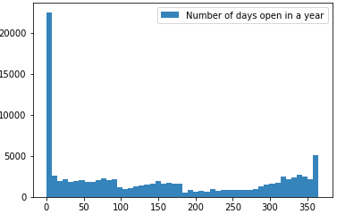
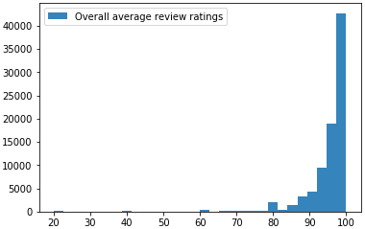
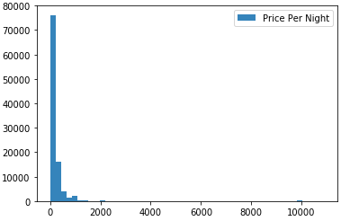
Histogram analysis (cont’d) 3of 3
Number of days open in a year
There are a seemingly high number of venues that are open zero times in a year. This variable may contain missing values and perhaps might need to be excluded. However, the distribution of the remaining venues is interesting and may provide insight on price points further downstream.
count 101106 | mean 146.4 | std 130.81 | min 0 | 25% 15 | 50% 117 | 75% 285 | max 365 | mode 0
kurtosis = -1.38 | skew = 0.38
Overall average review ratings
There appears to be outliers as one host received an overall 20% review score, but will remain in the dataset. The data is left skewed, as there are significantly more hosts receive perfect reviews.
count 83848 | mean 95.52 | std 6.9 | min 20 | 25% 94 | 50% 98 | 75% 100 | max 100 | mode 100
kurtosis = 33.19 | skew = -4.48
Price Per Night
There appears to be outliers as one host chargers nearly $10,000 per night. This seems extreme, and could easily be a typo or data entry error. The max amount charged will be reduced to < $2,000. There are also hosts charging $0, these will also be removed as this doesn’t seem realistic.
count 101106 | mean 215.1 | std 469.73 | min 0 | 25% 78 | 50% 125 | 75% 213 | max 10900 | mode 150
kurtosis = 284.13 | skew = 14.83

Slide 8
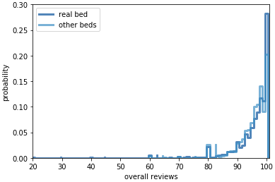
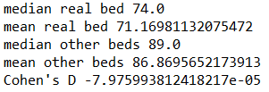
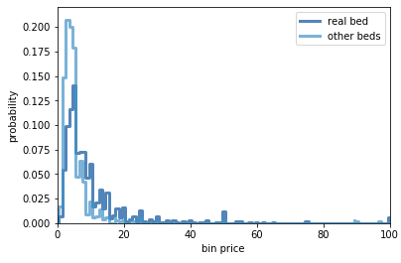
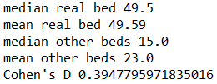
Probability Mass Function (PMF) - Beds
Real Beds vs. Other Beds reviews
Comparing the real beds to other types of beds shows that other beds appear to get better reviews than real beds.
Real Beds vs. Other Beds binned prices
By binning the prices, it becomes a little more obvious that other beds are probably cheaper than real beds.
The bins between 1-25 range from $1 - $505. The real beds have a lower probability within the 1-5 binned range and appear higher as the bins size increases. The remaining bins between 26 - 100 range in price from $525 - $1999

Slide 9
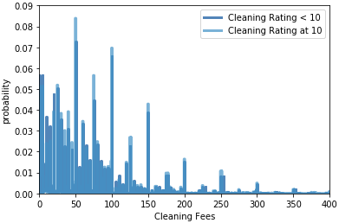

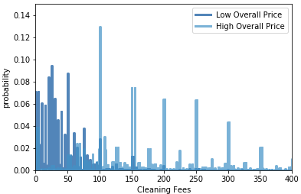
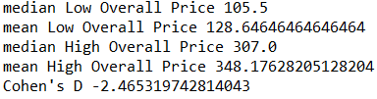
Probability Mass Function (PMF) – Cleaning
Cleaning Rating < 10 vs. Cleaning Rating = 10
It appears that lower cleaning ratings may be associated with the amount charged to the guest.
Lower Priced Rooms vs. Higher Priced rooms ($1-$100 vs. >$500)
It appears the higher the price of the room, the higher the cost of cleaning fees. This makes sense if you think about the amount of space that might need to be cleaned for a more expensive property.

Slide 10
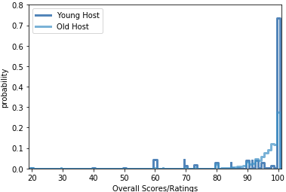

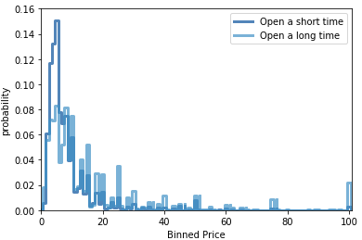

Probability Mass Function (PMF) – Hosts
Old Hosts vs Young Hosts
Findings yielded younger hosts tend to have higher overall scores than older hosts.
Venue Opened Year Round vs. Venue Opened = 365 Days
These findings appear to show that venues that are open for a short time tend to be more expensive than venues that are open year round.

Slide 11
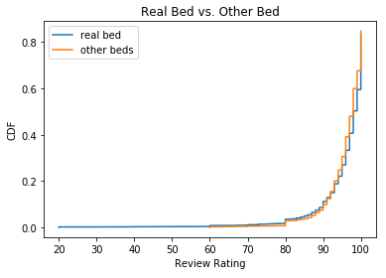
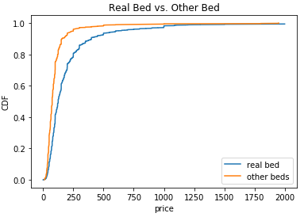
Cumulative Distribution Function (CDF) – Beds The initial understanding that real beds get worse ratings than other beds appears to be carried by the number of reviews that were < 60. The CDF of each rating after 60 appears in a similar fashion to the real beds, albeit slightly better. Other beds also appear to be cheaper as the 90th percentile contains prices that appear to be under $250. This is not the case for real beds as the 90th percentile appears to contain anything < $500

Slide 12
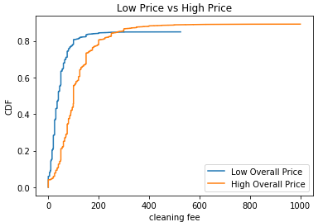
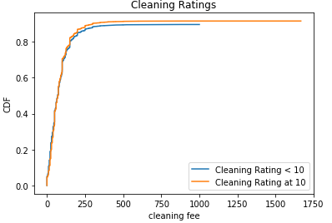
Cumulative Distribution Function (CDF) – Cleaning The difference in cleaning fees is a little more apparent with CDF, as lower priced Airbnb’s cleaning fees are lower up until around the 80th percentile. The cleaning guest ratings are nearly identical until the 80th percentile where cleaning ratings fall below 10 as cleaning fees increase above $250.

Slide 13
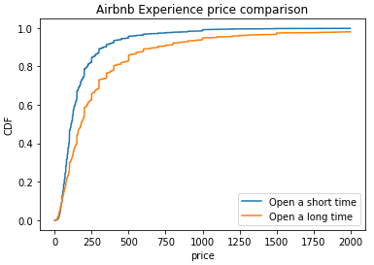
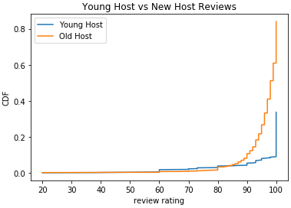
Cumulative Distribution Function (CDF) – Hosts The price comparison between hosts that are open year round to hosts that are opened 60 days or less show that long time hosts tend to have more expensive prices. Hosts that are haven’t had much Airbnb experience (Younger hosts) tend to have better reviews than Older hosts. But this also could be a result of minimal reviews, as Older hosts have more opportunities to have more reviews.

Slide 14
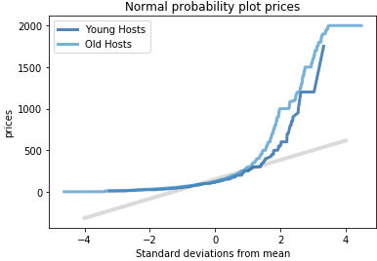
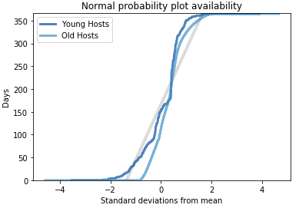
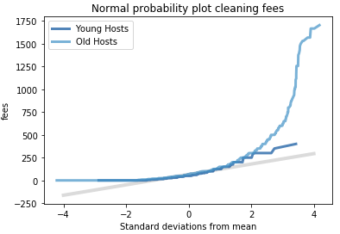
Modeling Distribution The majority of the variables in this dataset contain highly skewed data, and there aren’t a series of events within the data. So, coming up with a model for the distributions is challenging. The seniority of a host is the closest distribution to Gaussian distribution, and interesting enough these models offer the closest insight to a true model of the distributions. On the right are a few examples. The first is a comparison of a normal probability plot between two variables. The host rates between $0 and roughly $250 appear to fit the model well, but quickly becomes a poor model as prices increase. The next model displays similar results for cleaning fees. Between $0 and $100 follow closely in line with the model, but at $250 the model becomes irrelevant. The last model on the far right shows that younger hosts fit sort of well with the model when it comes to modeling the number of days a host will be available throughout the year.

Slide 15
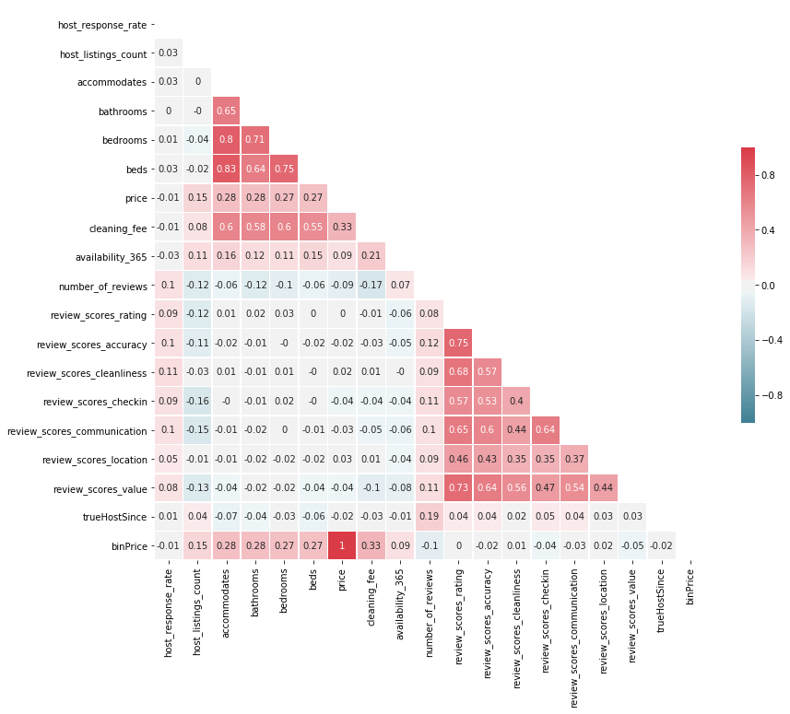
Correlation The heatmap to the left provides a visual of variables and how well they’re correlated. Inside each block is Pearson’s correlation coefficient. There appears to be little to no correlation between the accommodations (bedrooms, beds, etc.) and the review scores. However, the accommodations appear to correlate with the cleaning fee and price ranges.

Slide 16
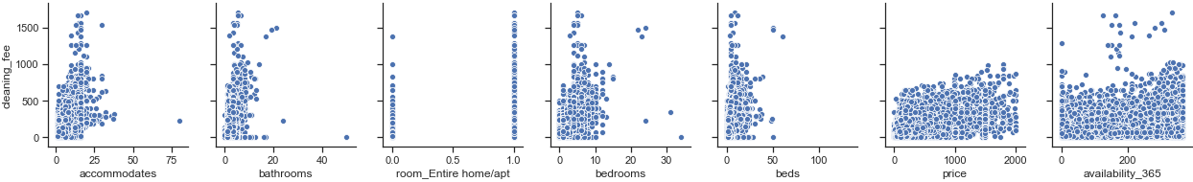
Scatter Plot – Cleaning Fees The scatter show a somewhat linear relationship with cleaning fees, overall price, the number of bathrooms, bedrooms, and beds available at the Airbnb. The “entire room” is a Boolean field that indicates whether the location was for the entire home or not. This may be beneficial for logistic regression.

Slide 17
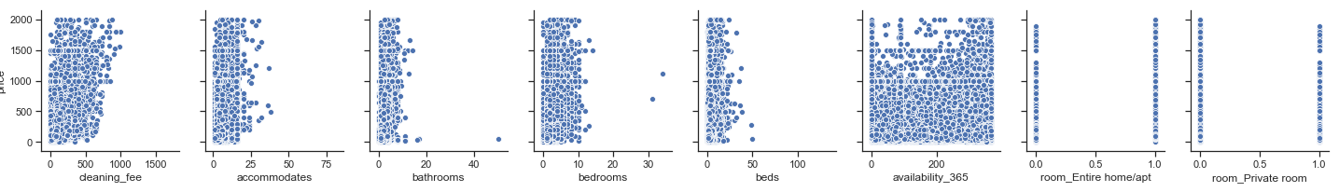
Scatter Plot – Price The scatter plots show a somewhat linear relationship with the days a host has been a host and the number of listings available and the number of reviews received. The 1-10 scale ratings are hard to gage since there are so few selections (1-10).

Slide 18
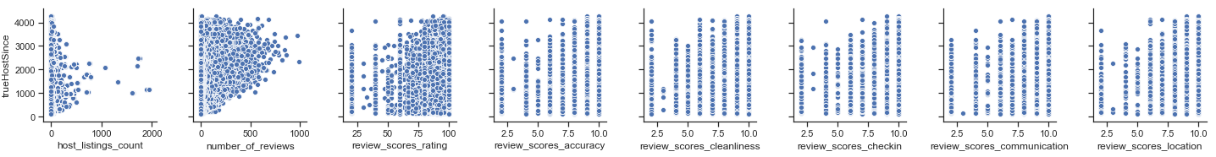
Scatter Plot – Hosts The scatter plots show a somewhat linear relationship with the days a host has been a host and the number of listings available and the number of reviews received. The 1-10 scale ratings are hard to gage since there are so few selections (1-10).

Slide 19
Hypothesis Testing
After several test statistics, the Hypothesis testing results came back 0.0
According to the text, the reason it is showing 0.0 is because p<.001. This is surprising and doesn’t make sense based on the past correlation metrics and distribution of the data

Slide 20
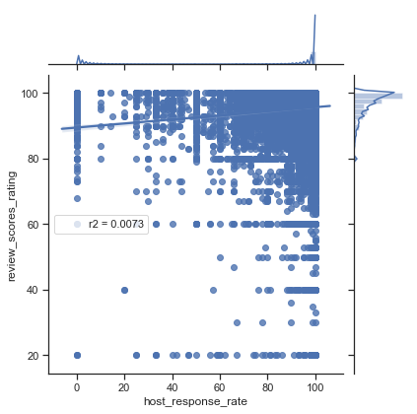
Linear Models Question - 1
Do hosts with less response time tend to get worst reviews than high response time hosts?
There is minimal correlation between the review score and the host response rate.
The model on the right has a very low R^2 and a very high p-value, indicating that host response rate is not a good predictor of the review score rating.

Slide 21
Linear Models Question - 2
Do Real Beds cost more or get better reviews than non-real beds?
There is correlation between the number of real beds and the price, but this makes intuitive sense as more beds would mean more space, and more real estate would most likely cost more to rent. Also, “other” beds include pullout sofas and couches. So yes, to sleep in a real bed you will most likely pay more money.

Slide 22
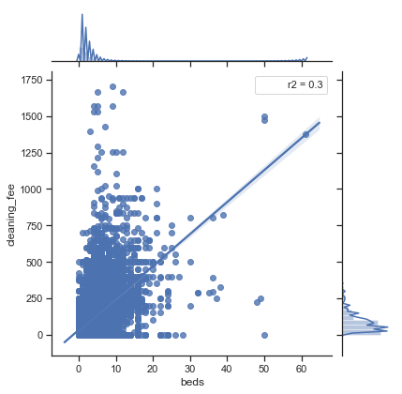
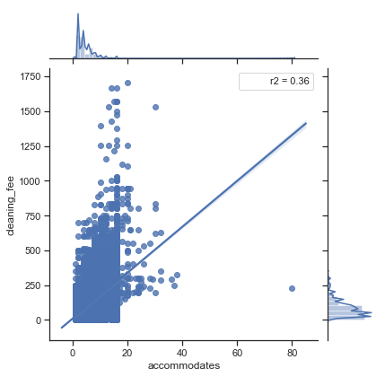
Linear Models Question - 3
What impacts a location’s cleaning cost?
There are several variables that have a high correlation to the cleaning fees associated with an Airbnb. Most make intuitive sense (living quarters, the number of people it accommodates, etc.)
The number of beds accounts for roughly 30% of the variability in the cleaning costs.
The number of people the location accommodates accounts for roughly 30% of the variability in the cleaning costs.
Its pretty clear there is some collinearity between the variables, but it at least shows the number of bathrooms, bedrooms, beds, and whether the location is open year round all play a role in the cleaning fees

Slide 23
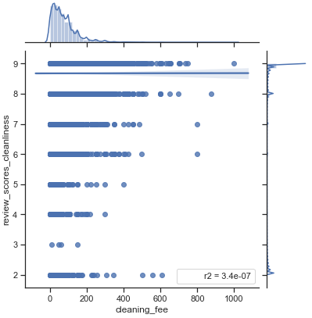
Linear Models Question - 4
Do locations with higher cleaning fees have better cleaning reviews?
This was a challenging question to answer as the cleaning reviews are on a 1-10 scale and the majority of the reviews were at a 10. Even removing the 10 rated scores, cleaning fees appear to take no significant role in how well people rate the room’s cleanliness.

Slide 24
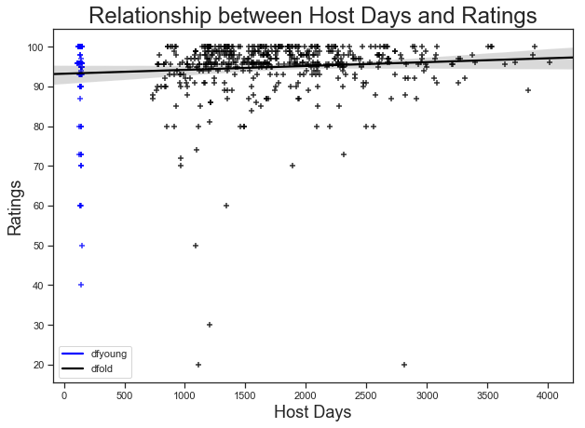
Linear Models Question - 5
Do long time hosts tend to get better reviews?
There was some correlation (.19) between the number of days a host has been hosting an Airbnb and the ratings received, but there doesn’t appear to be anything significant that would indicate this is a good predictor for the data.

Slide 25
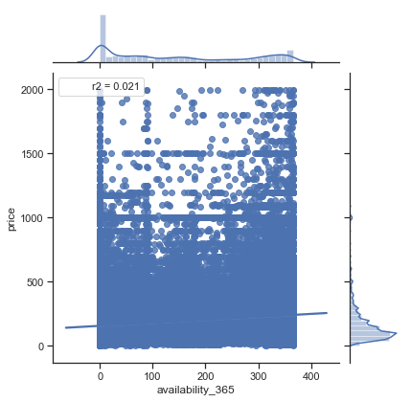
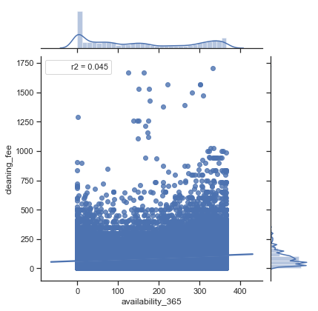
Linear Models Question - 6
Does the number of days the venue is open impact the price points?
When the availability_365 variable was reviewed in the histogram, it appeared to be highly volatile. It was challenging to see skewness in the shape of the data as the days open year round were highly spread out.
This variable is not a good predictor of the overall price of the location.
However, the cleaning fee does have some correlation, even if it only accounts for 4% of the cleaning fee variability.

